Slide 1
Form Filler
Miles Hays, Fortune Nwokejiobi, Lucas Eifert
Notes:
1 – all
2, 3 – Fortune
4 – Lucas
5, 6 – Miles
7, 8, 9 – Fortune
10, 11, 12 – Lucas
How Autofill Works – Miles
13, 14 – Fortune
15, 16 – Lucas
17, 18, 19 – Miles
20 – Fortune

Slide 2
Agenda
01
05
02
06
03
04
About FormFiller
Future revisions
Technical details
Conclusion
Member walkthrough
Organization walkthrough

Slide 3


Slide 4
Technical details
React-next.js
Node and Express backend
We use react and next.js for the front-end, and certain server functionalities.
The server is built on the Express server software, built on the Node.js JavaScript interpreter.
MySQL database
We a using a MySQL database to hold user profiles, organizations, and forms

Slide 5
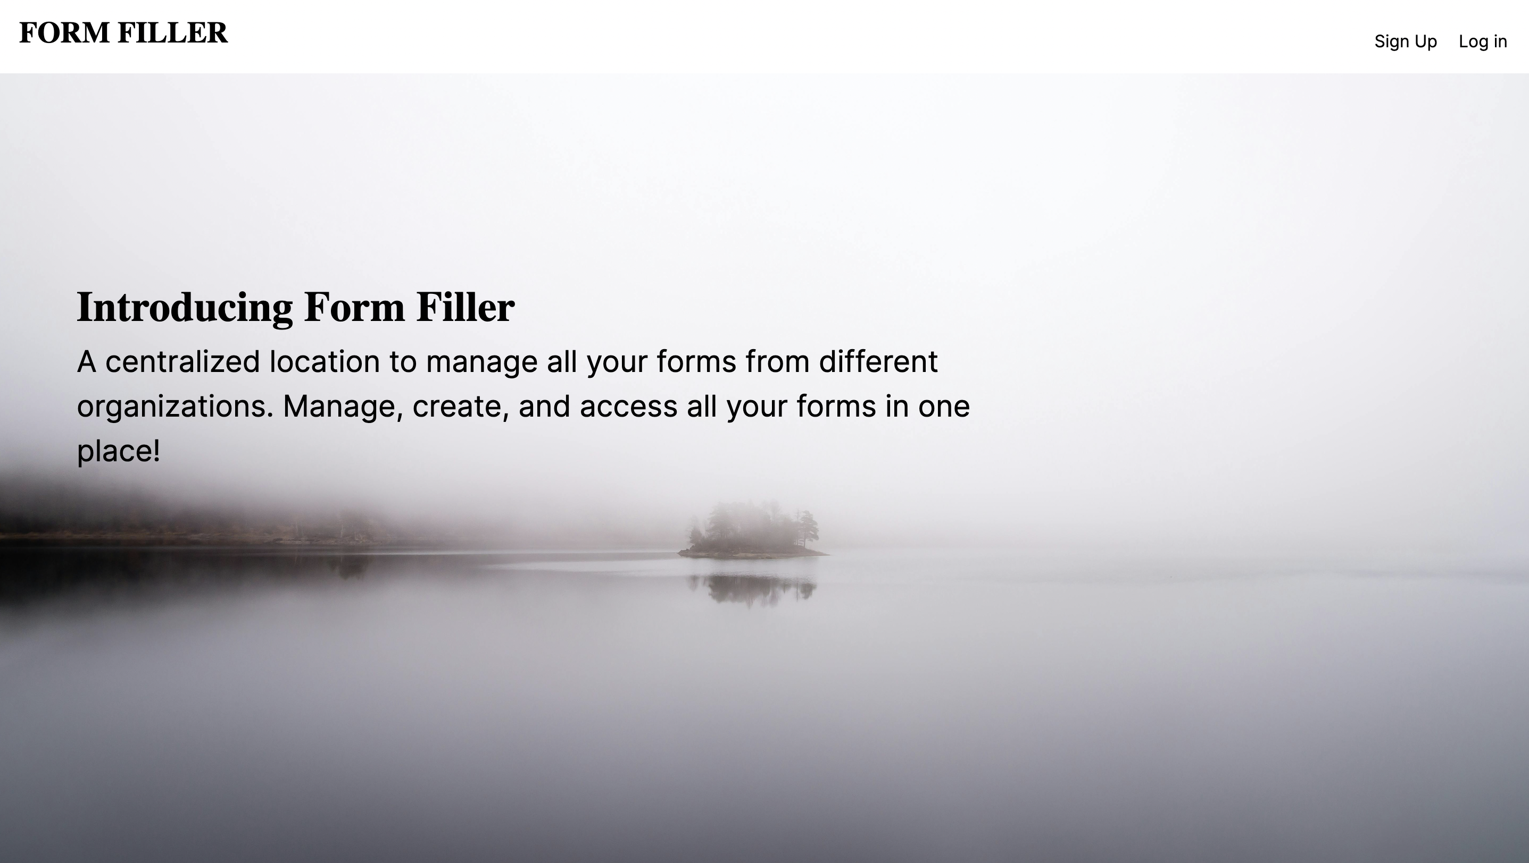

Slide 6
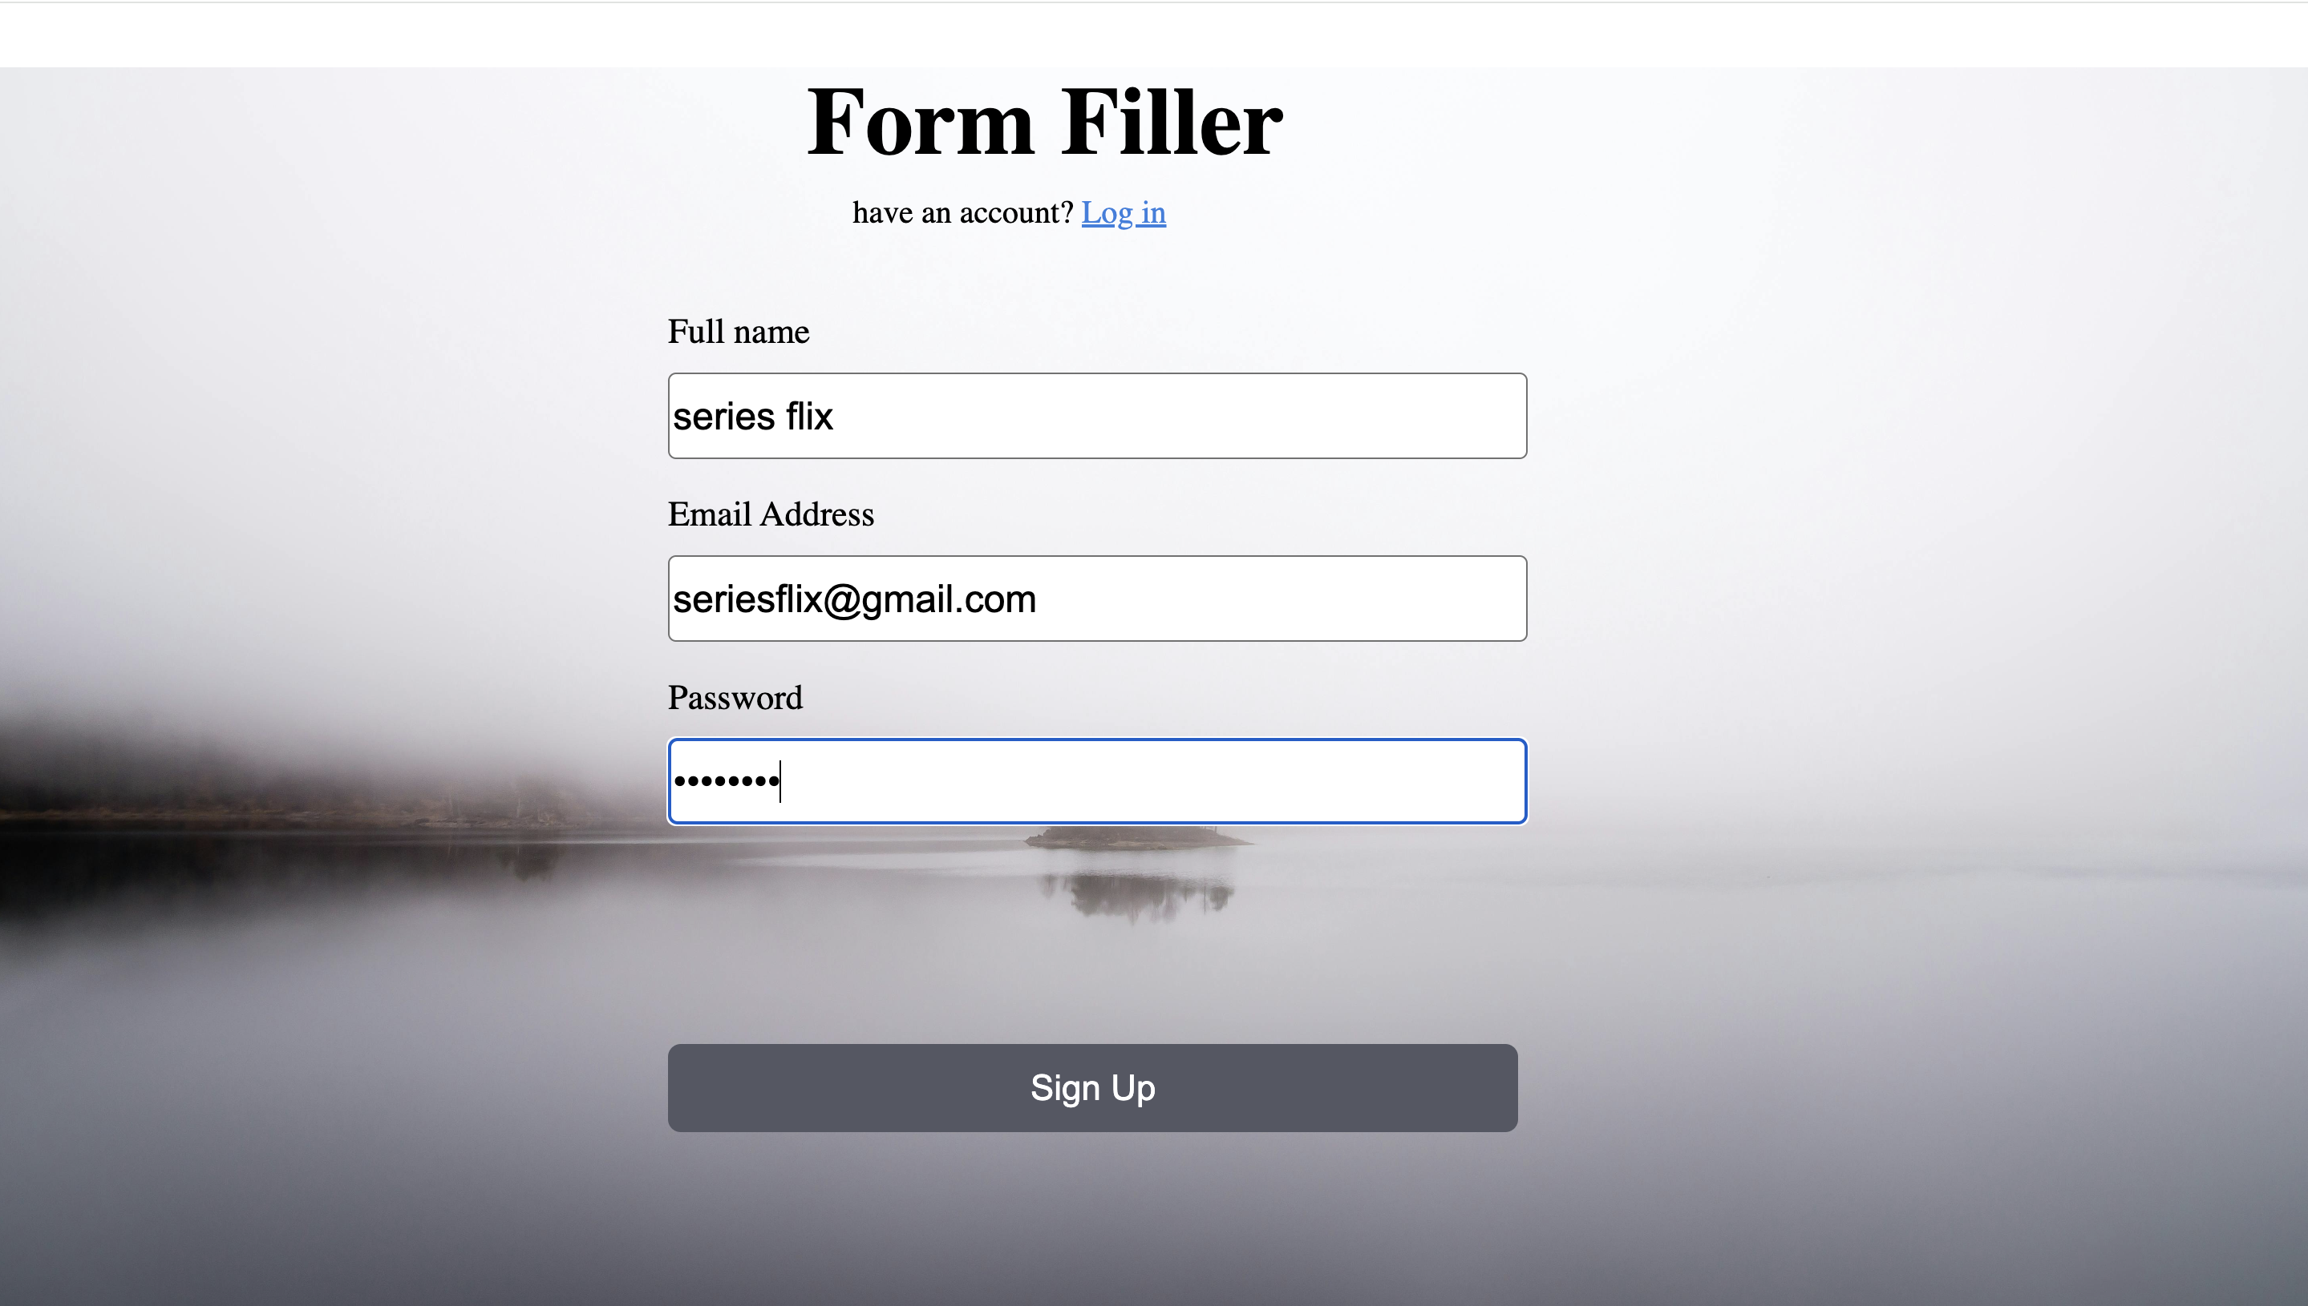

Slide 7
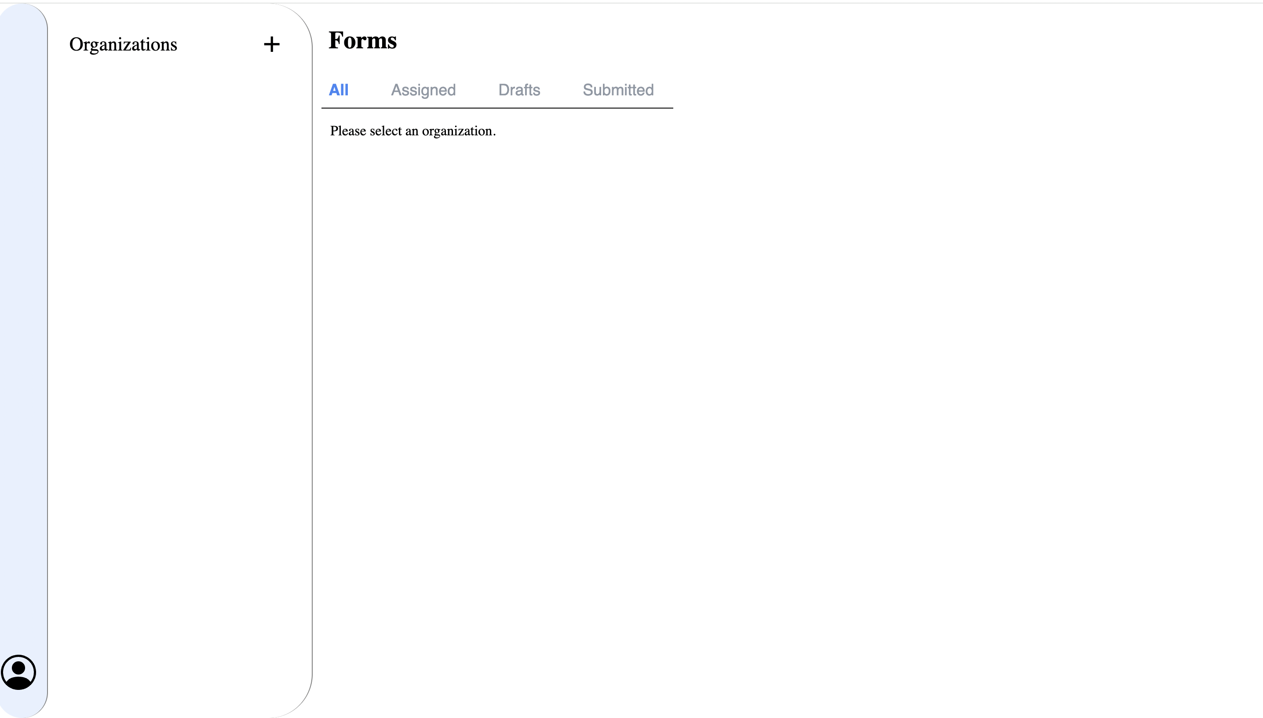

Slide 8
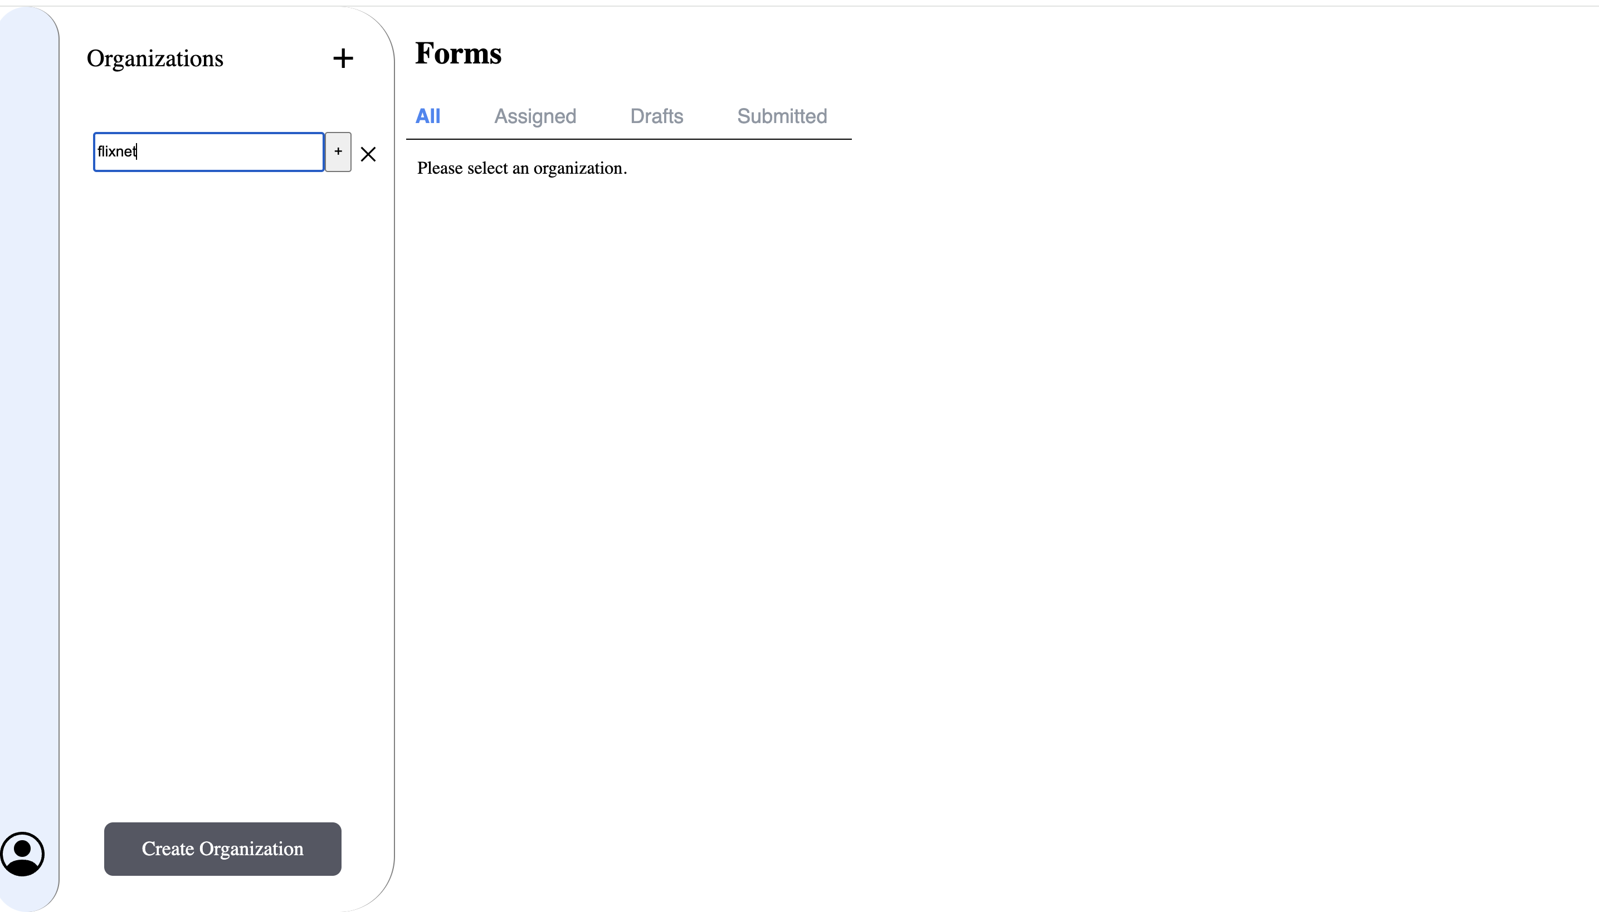

Slide 9
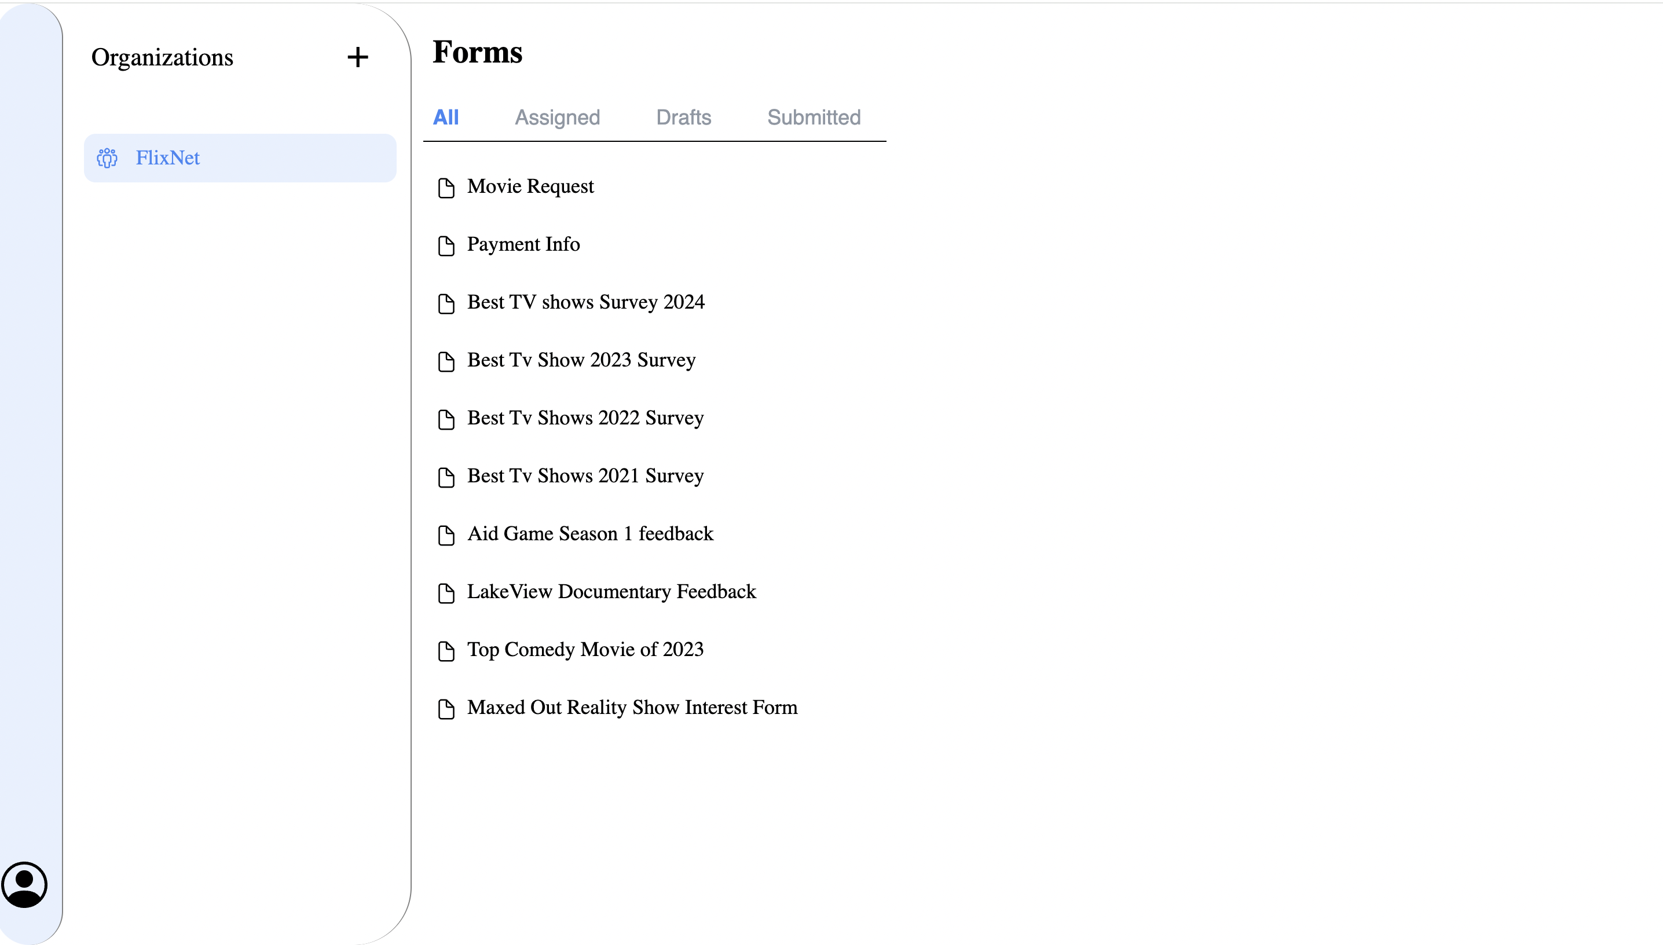

Slide 10
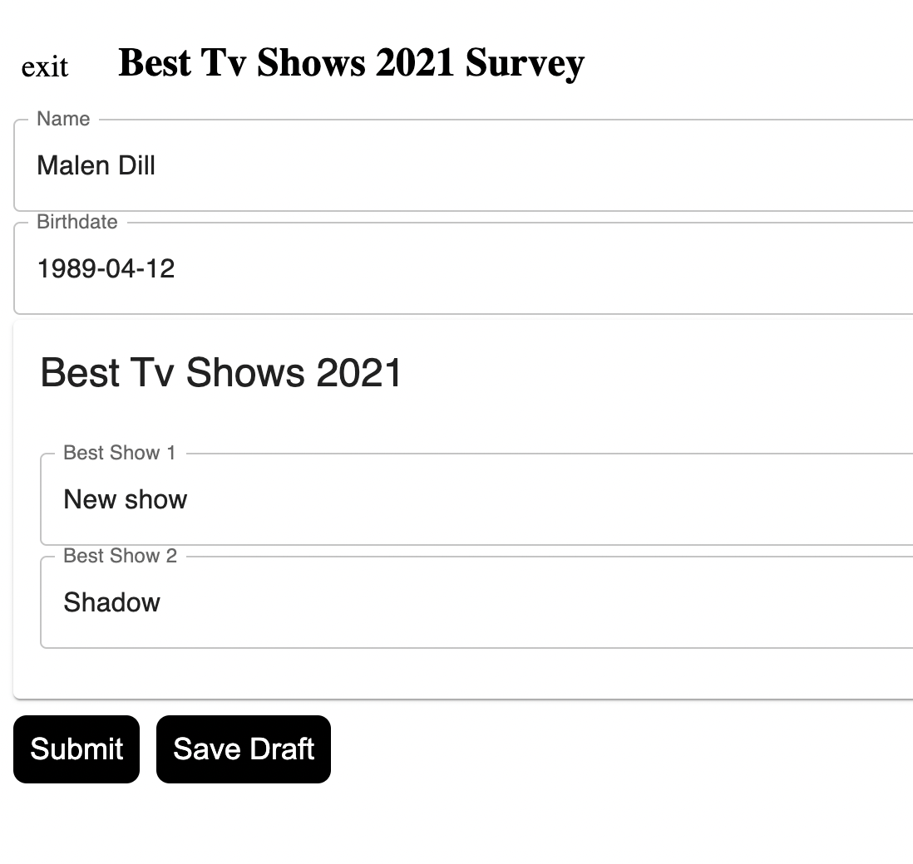
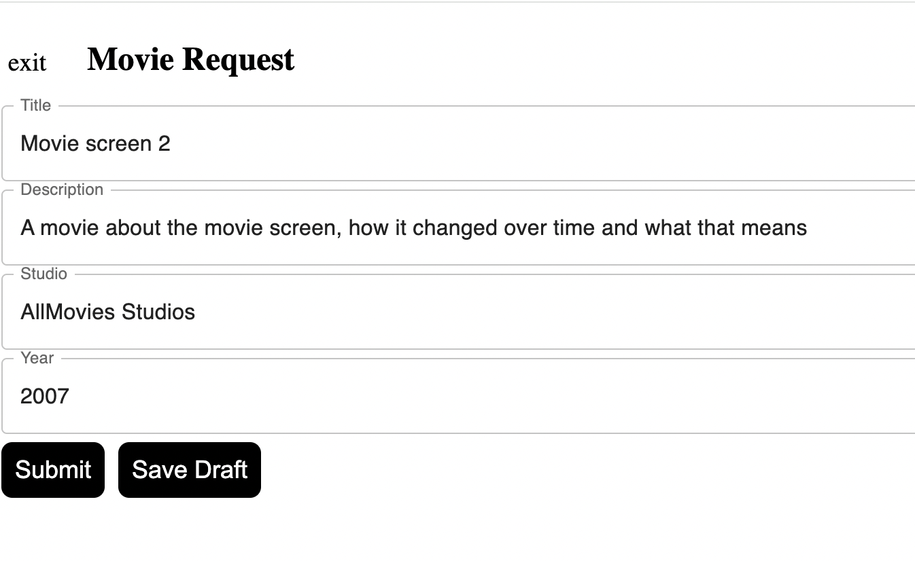

Slide 11
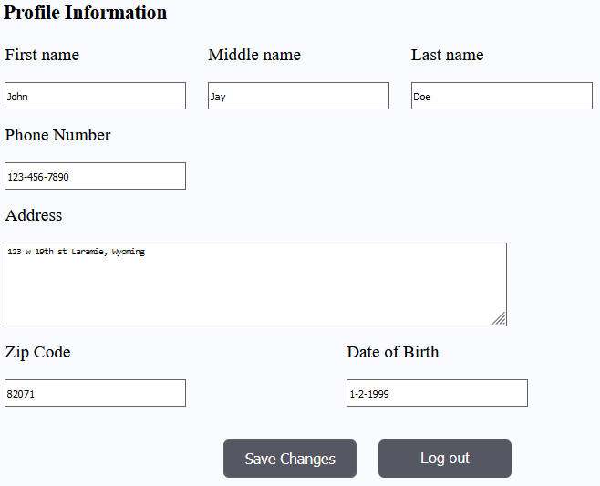
Profile Page
User is prompted to enter information after signing up.
Personal information is not required to use the app.

Slide 12
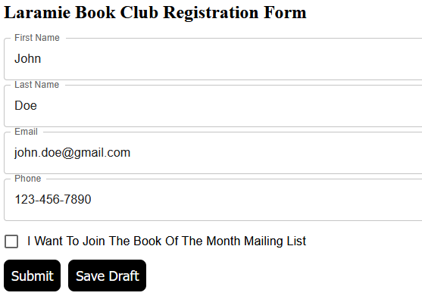
Automated Form Filling
Common information will be automatically entered into forms.

Slide 13
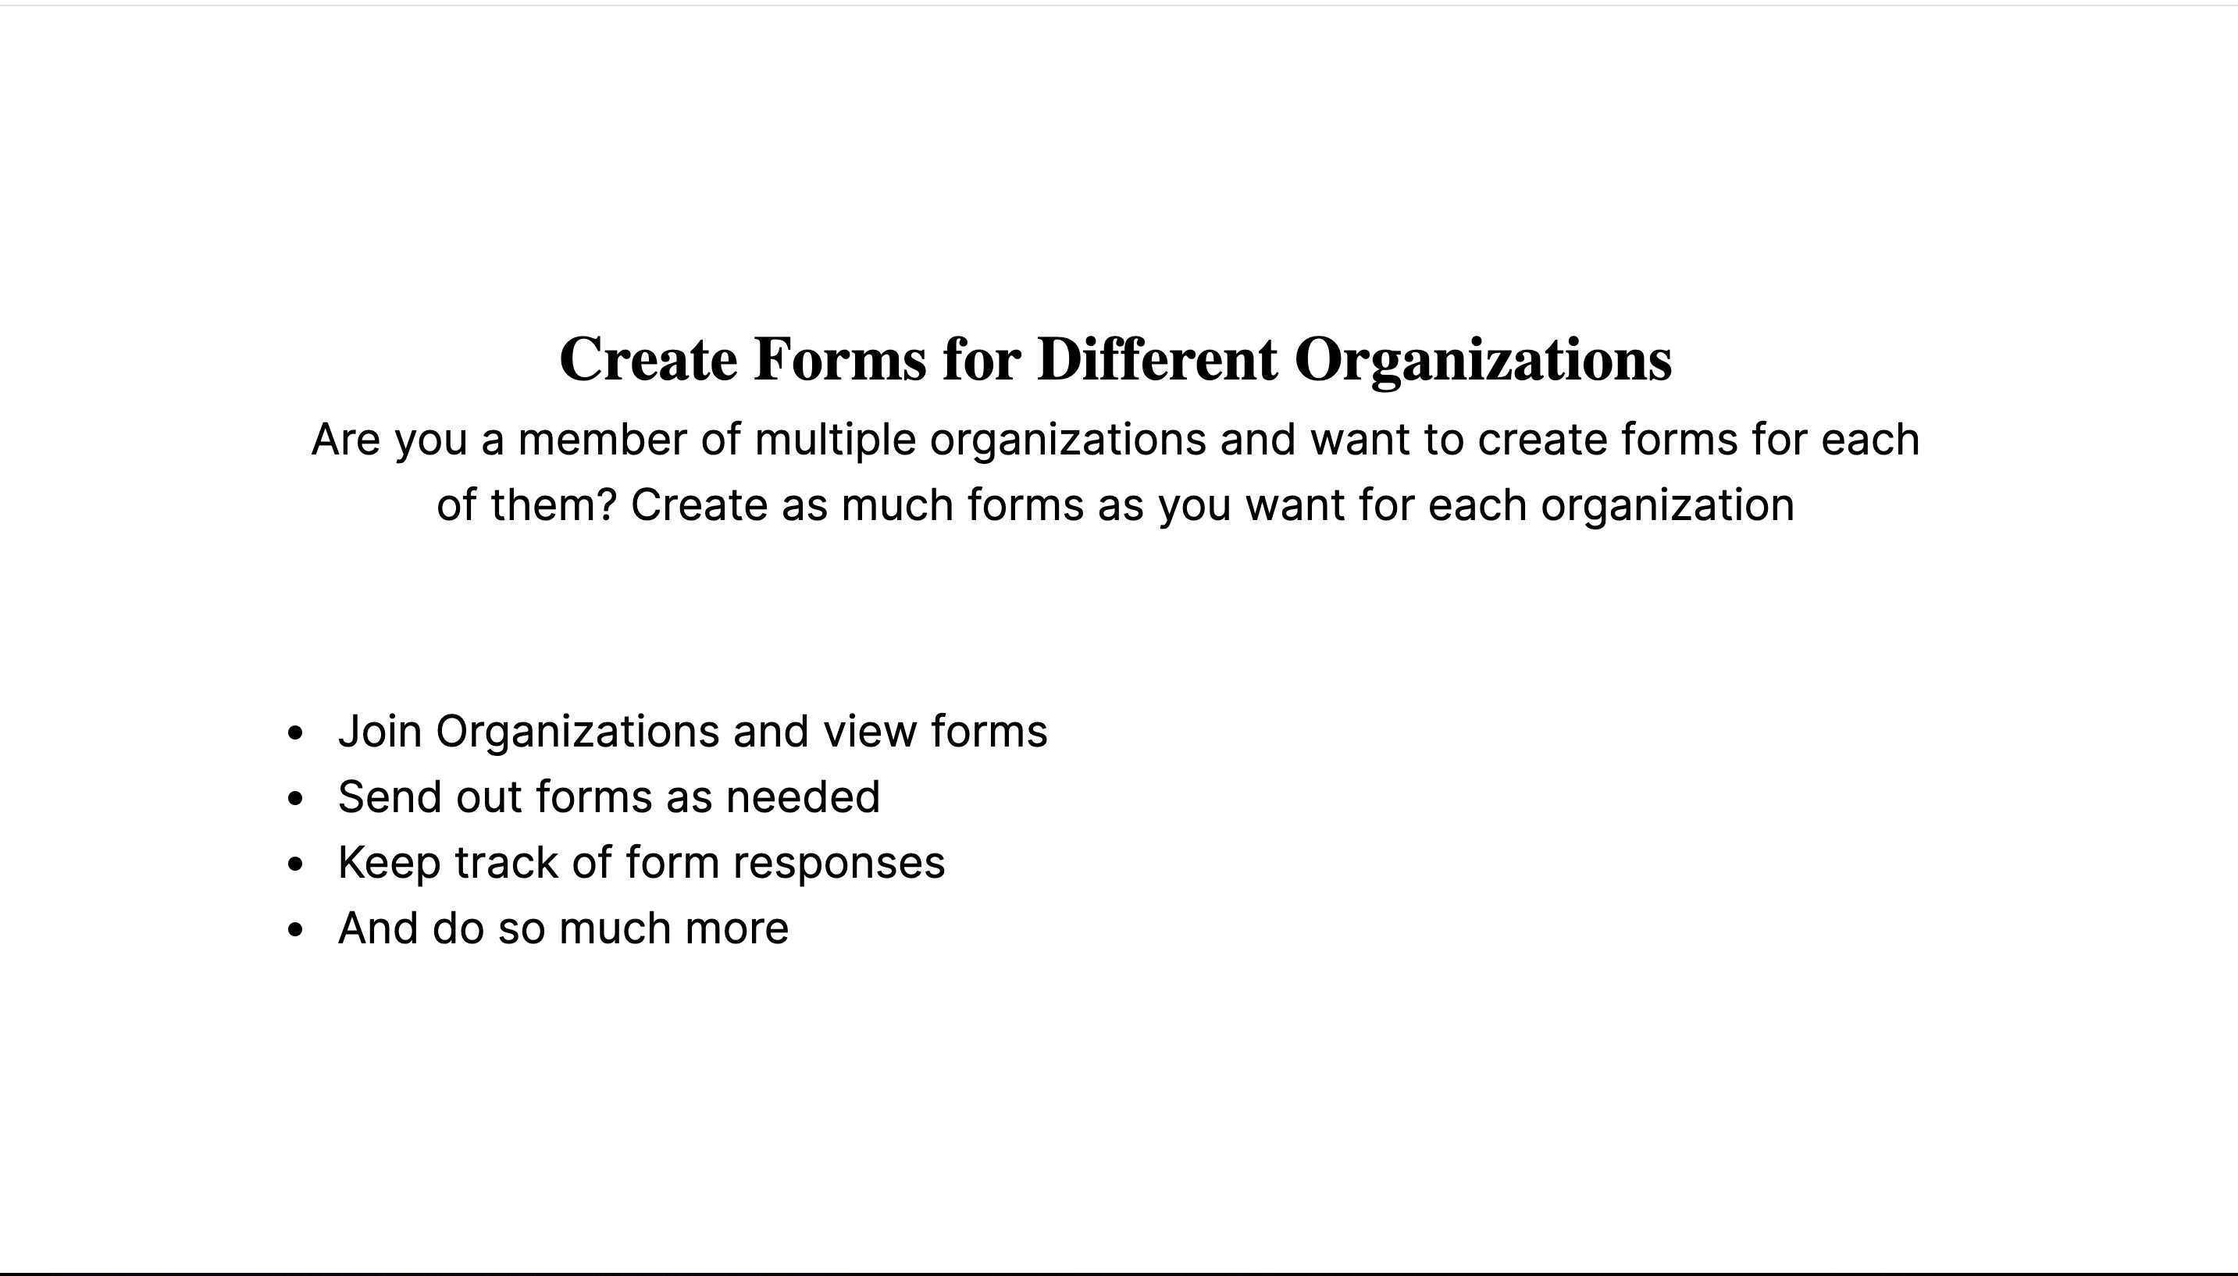

Slide 14
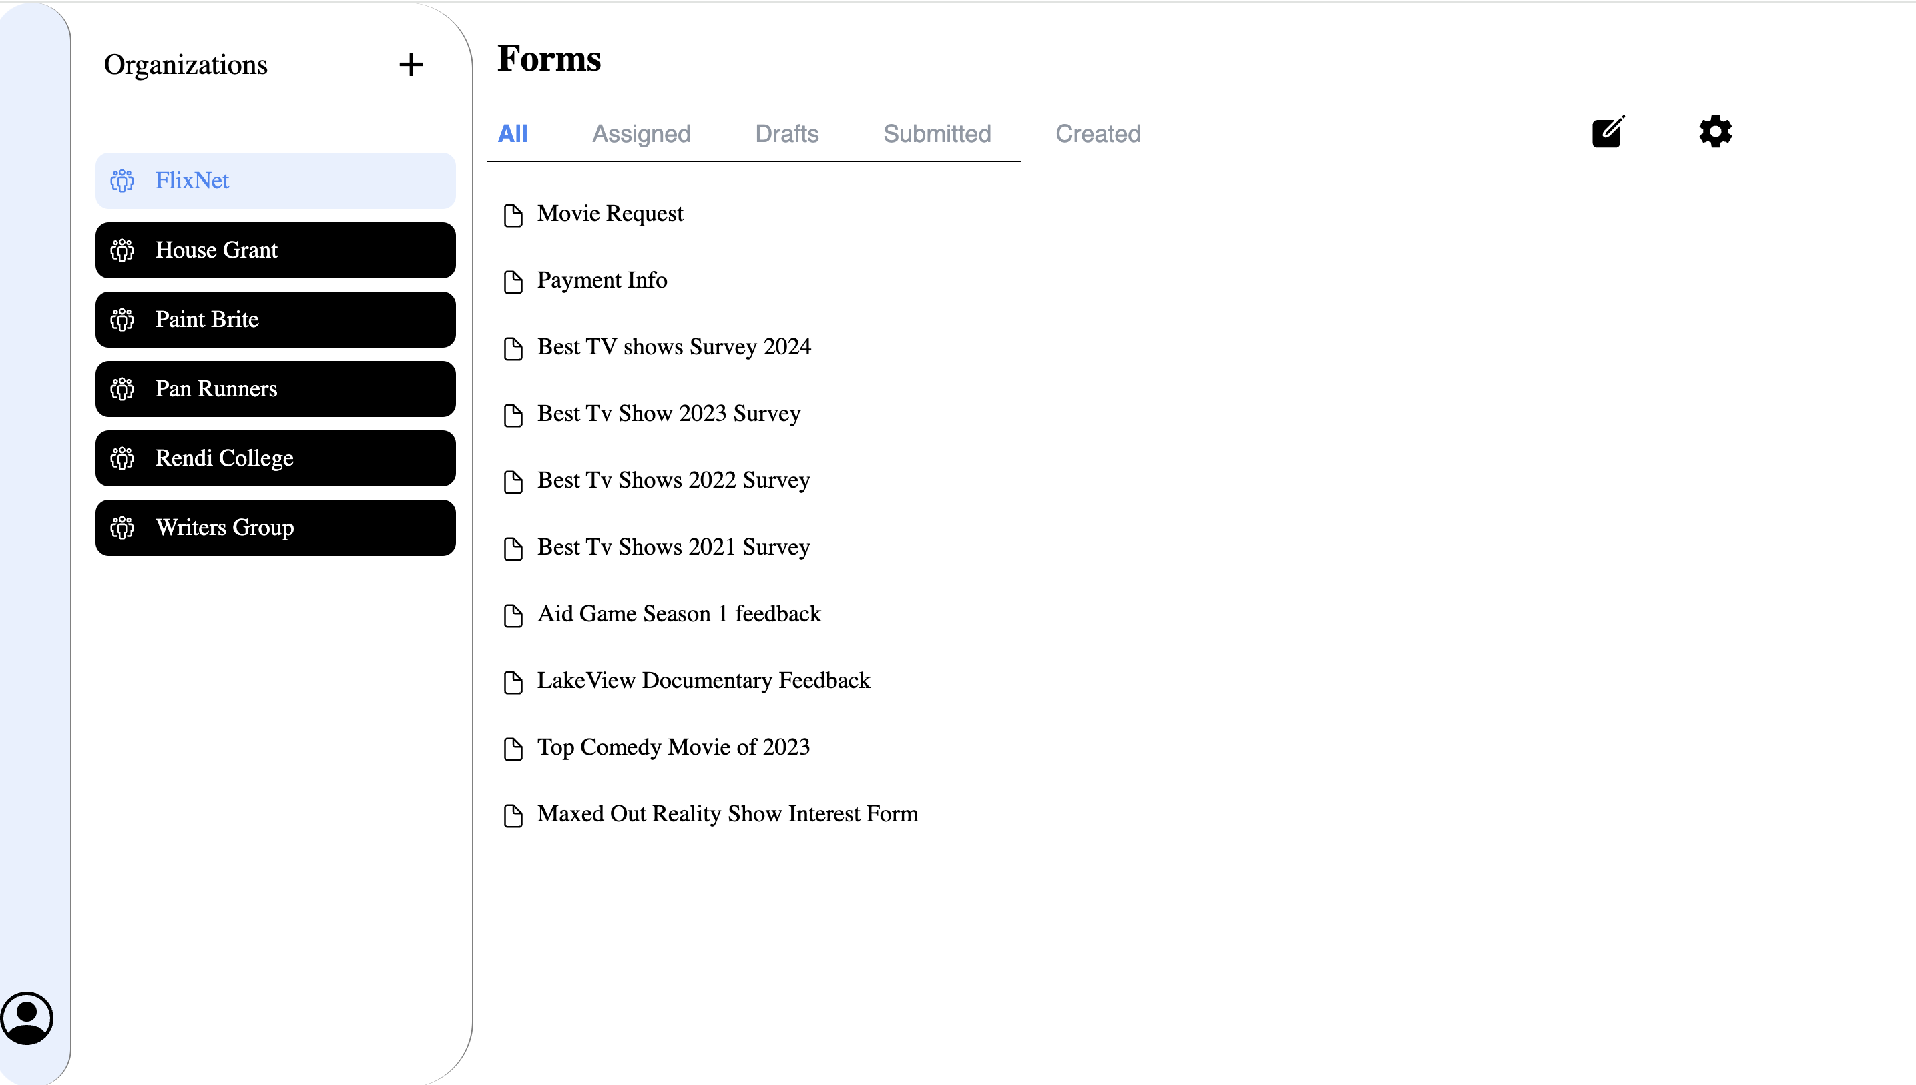

Slide 15
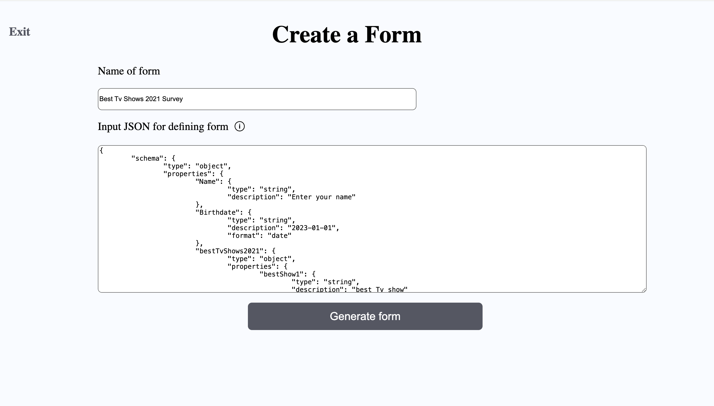

Slide 16
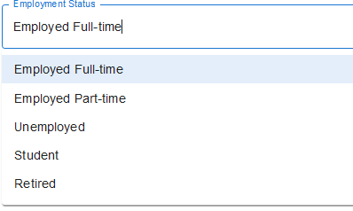
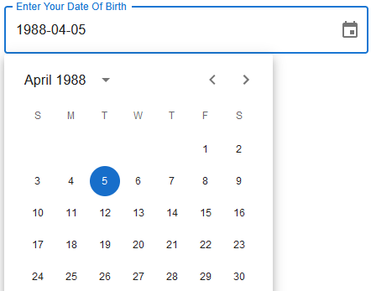


Slide 17
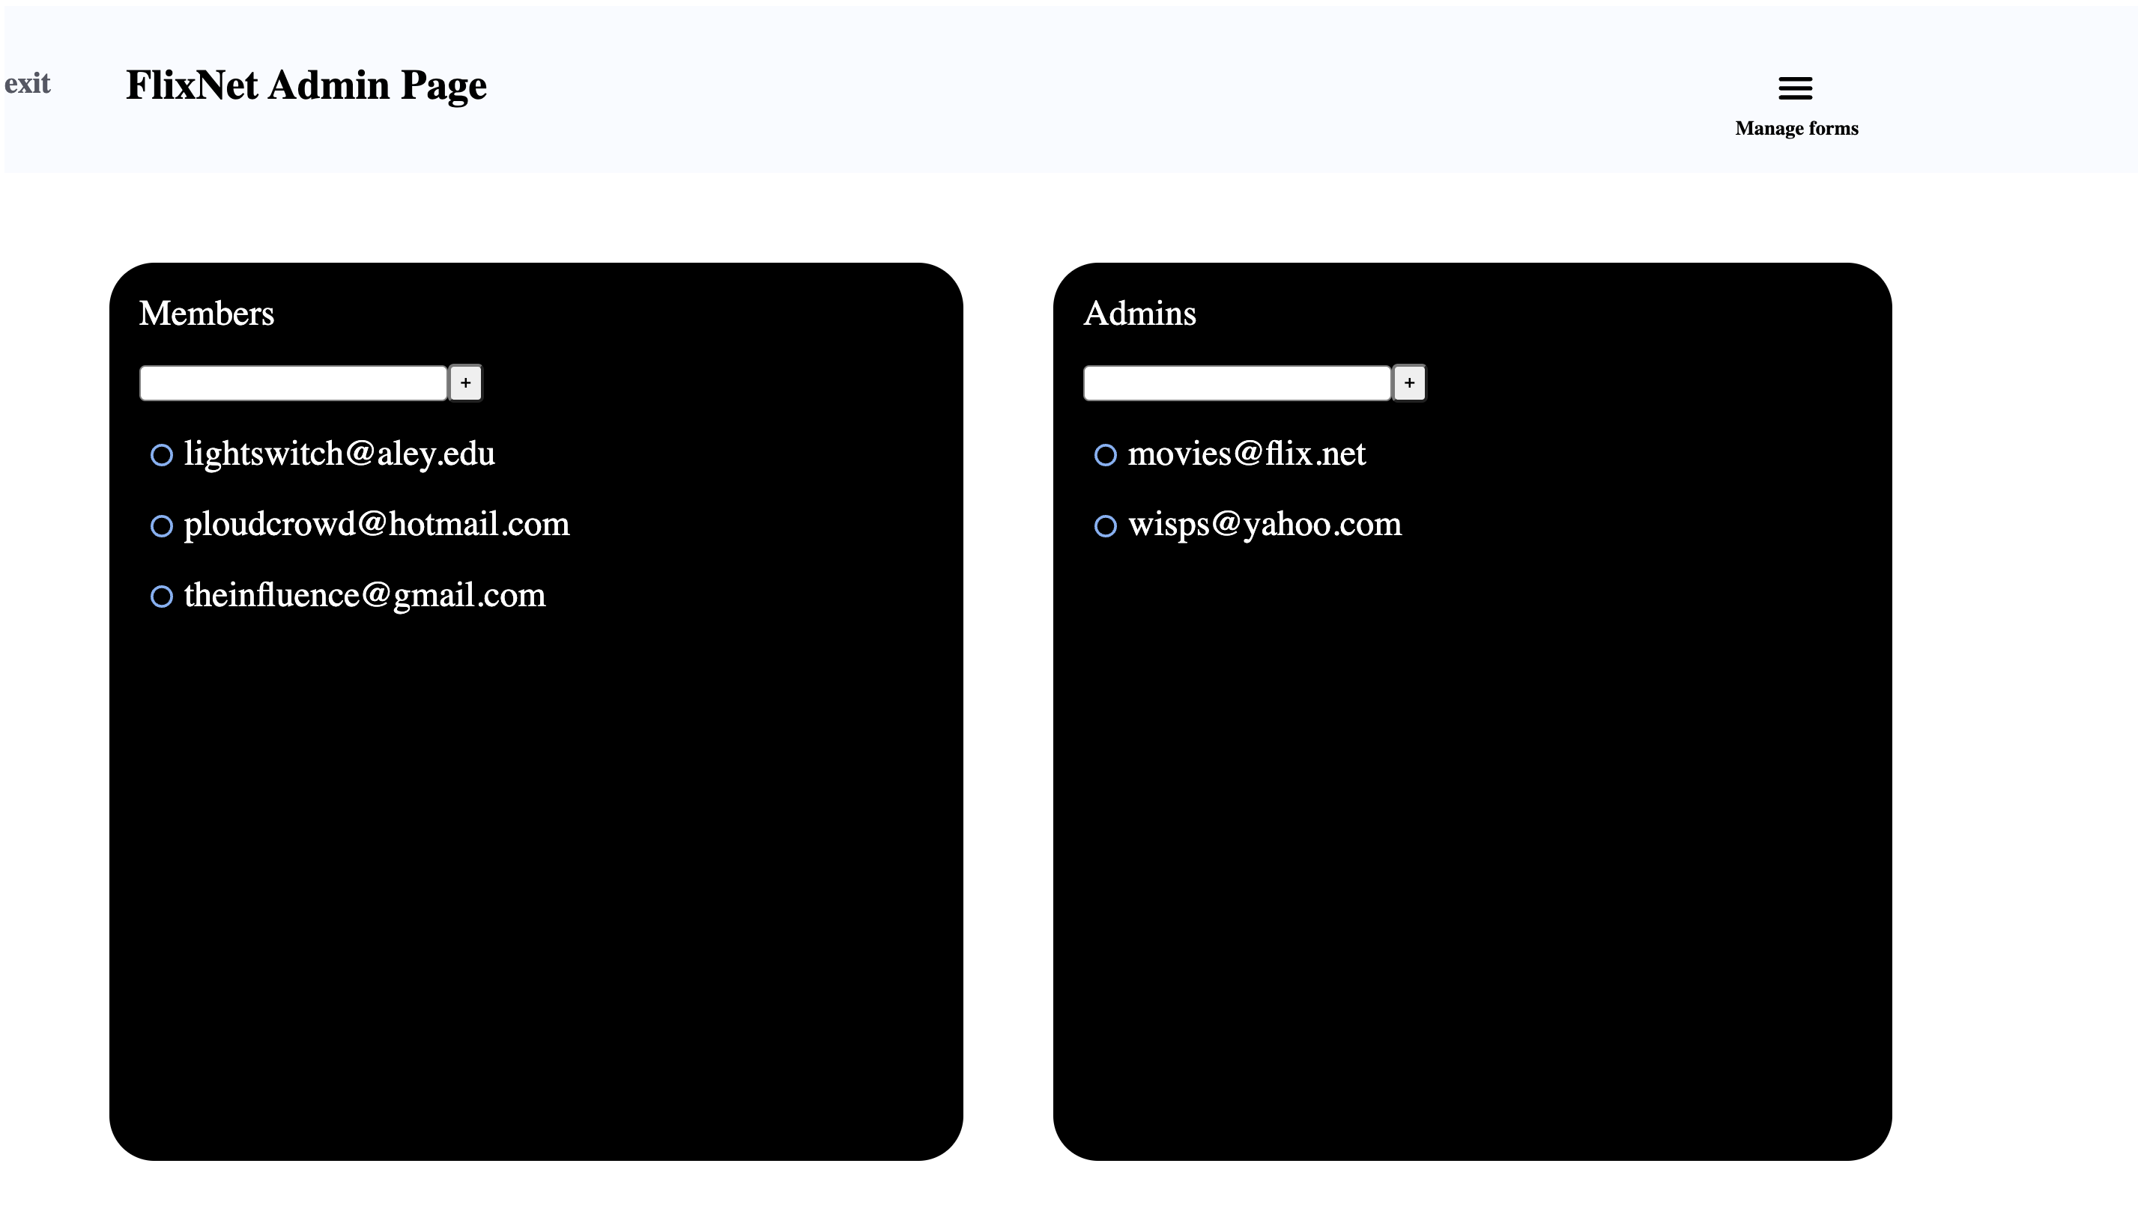

Slide 18
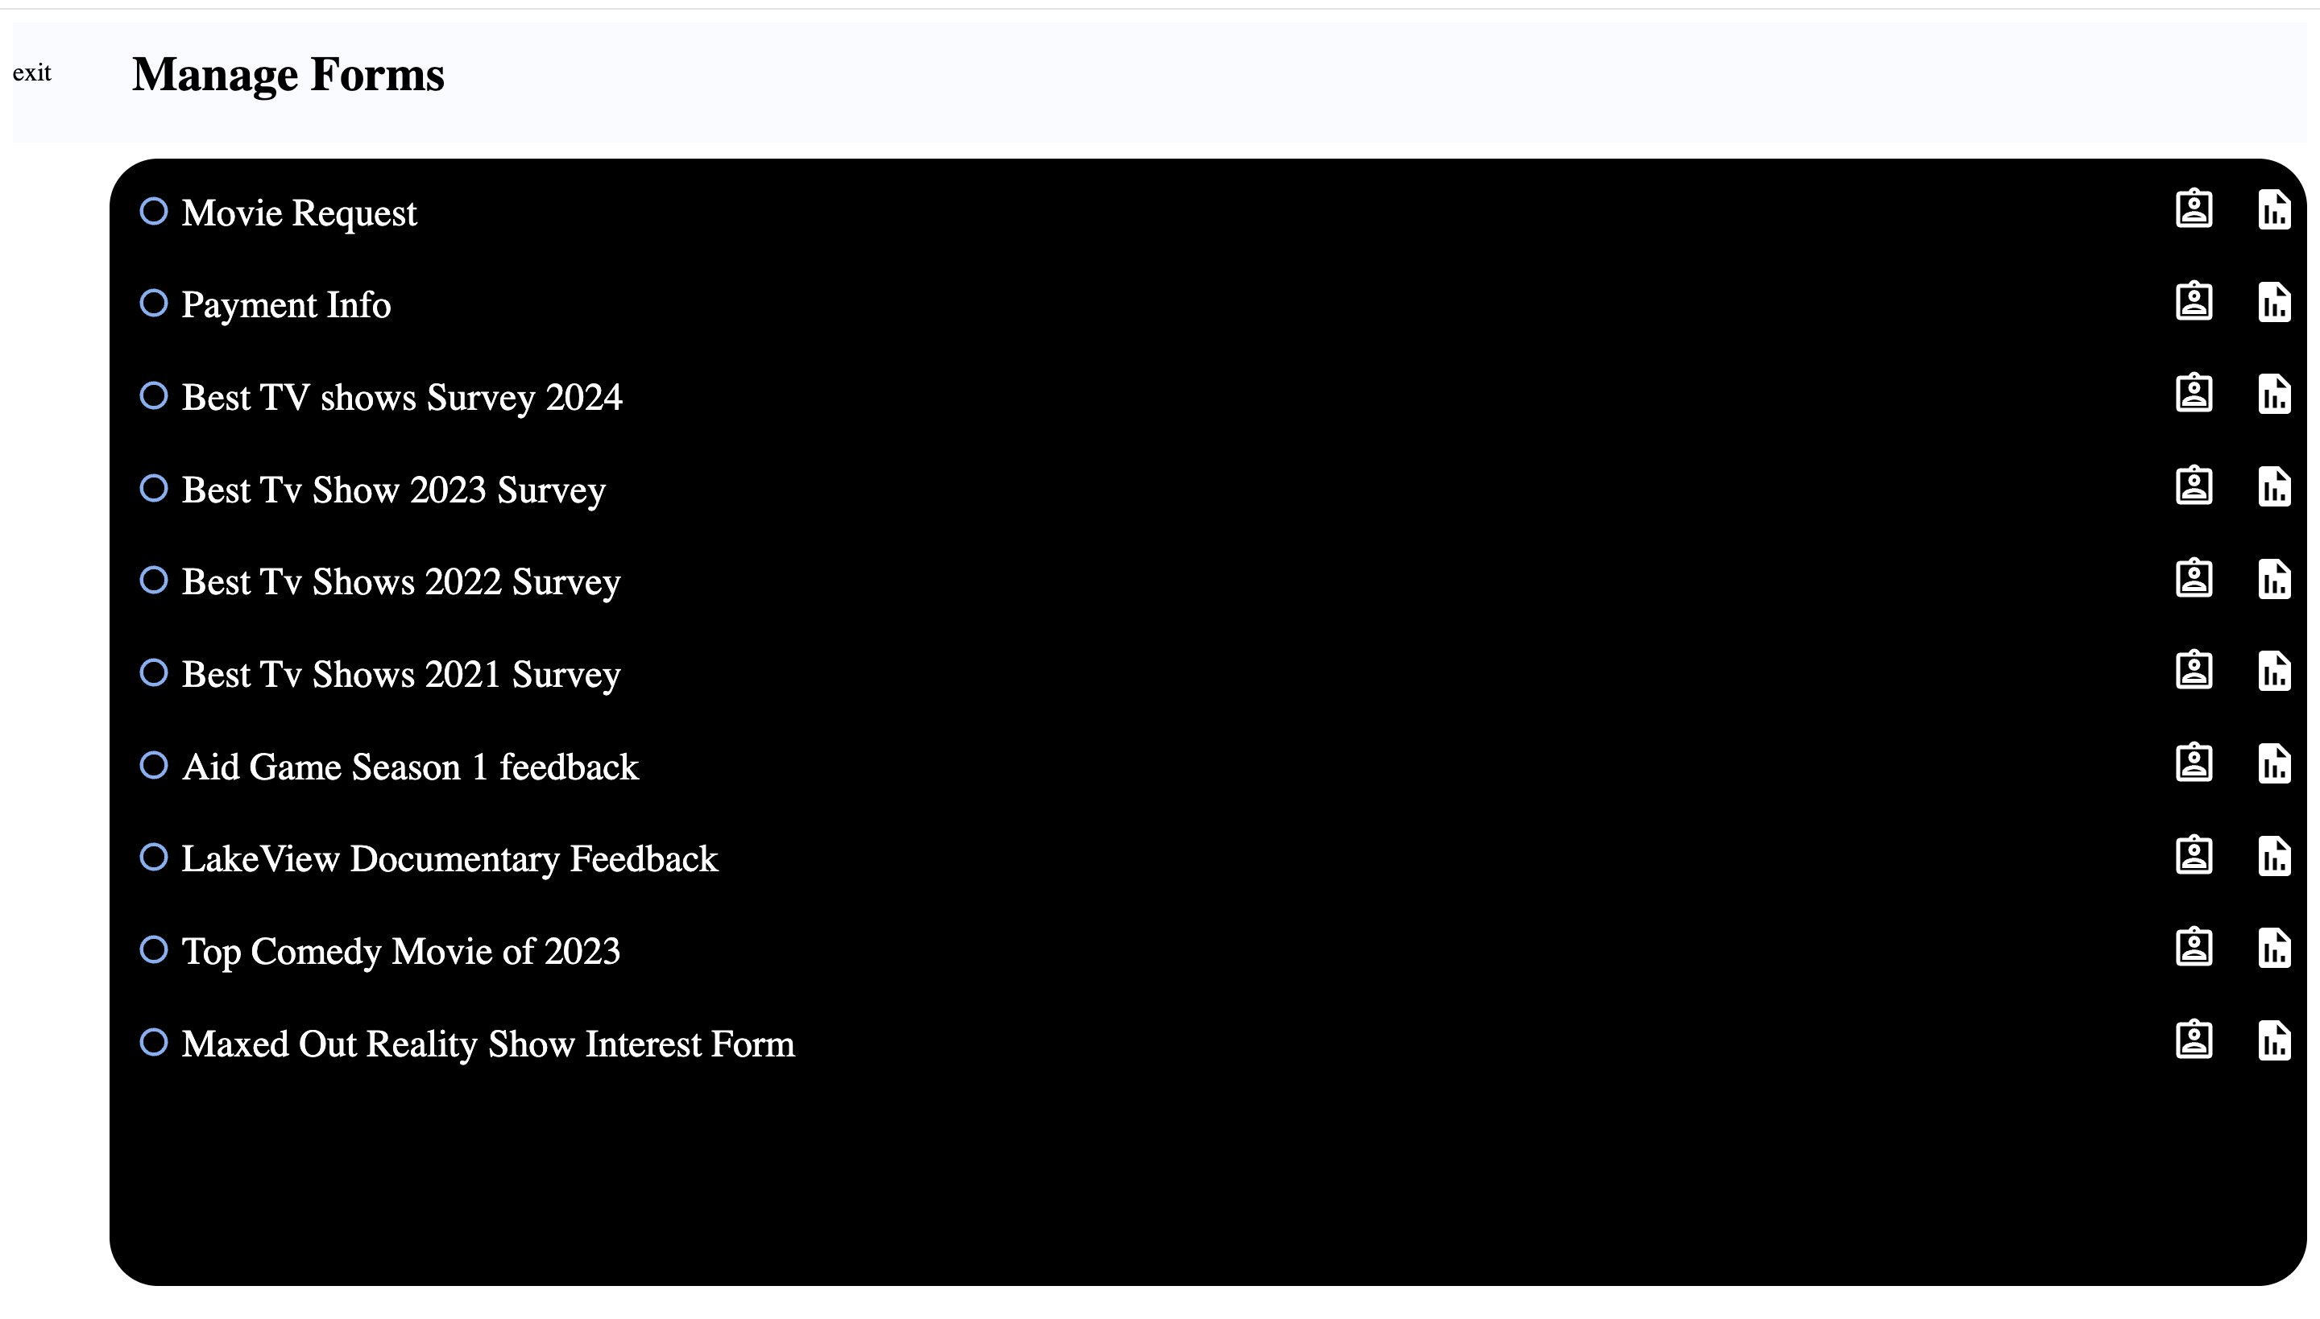

Slide 19
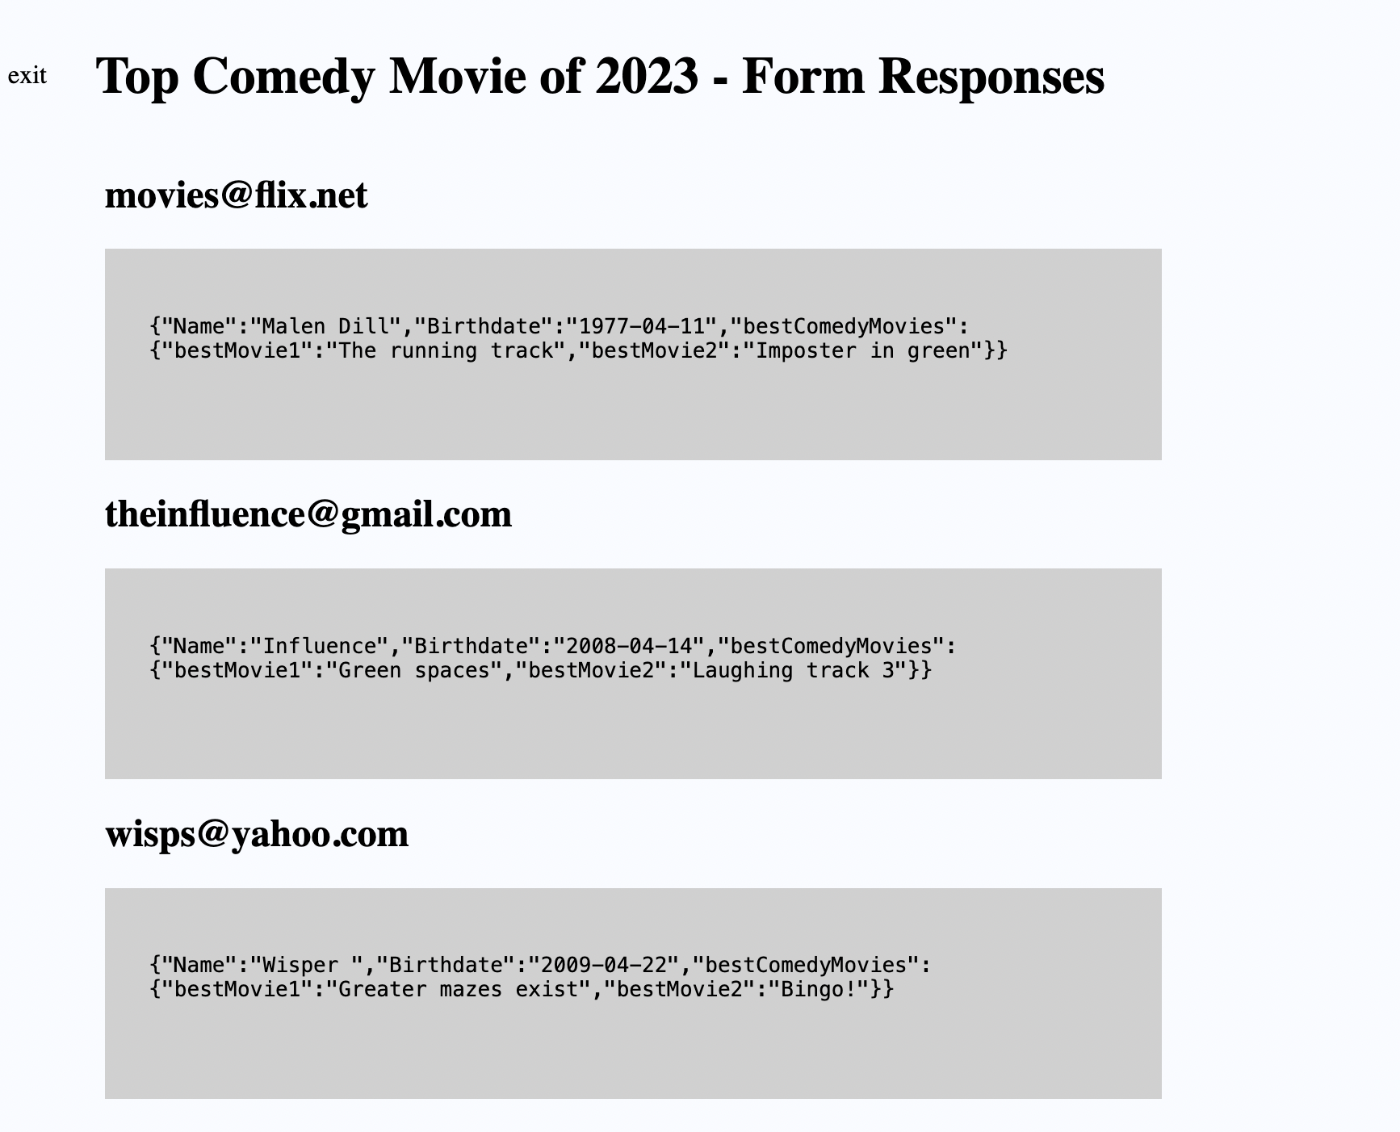

Slide 20
Future Revisions
Use of invite links
Form Signing
Use invite links to join organizations
We can allow users to sign forms and save their signatures
GUI Form creation
Drop Next.js
For now, we use jsonApi to create forms, we can also create a graphical form builder for users
Next.js has had some issues, so we believe not using next.js will be a good idea

Slide 21
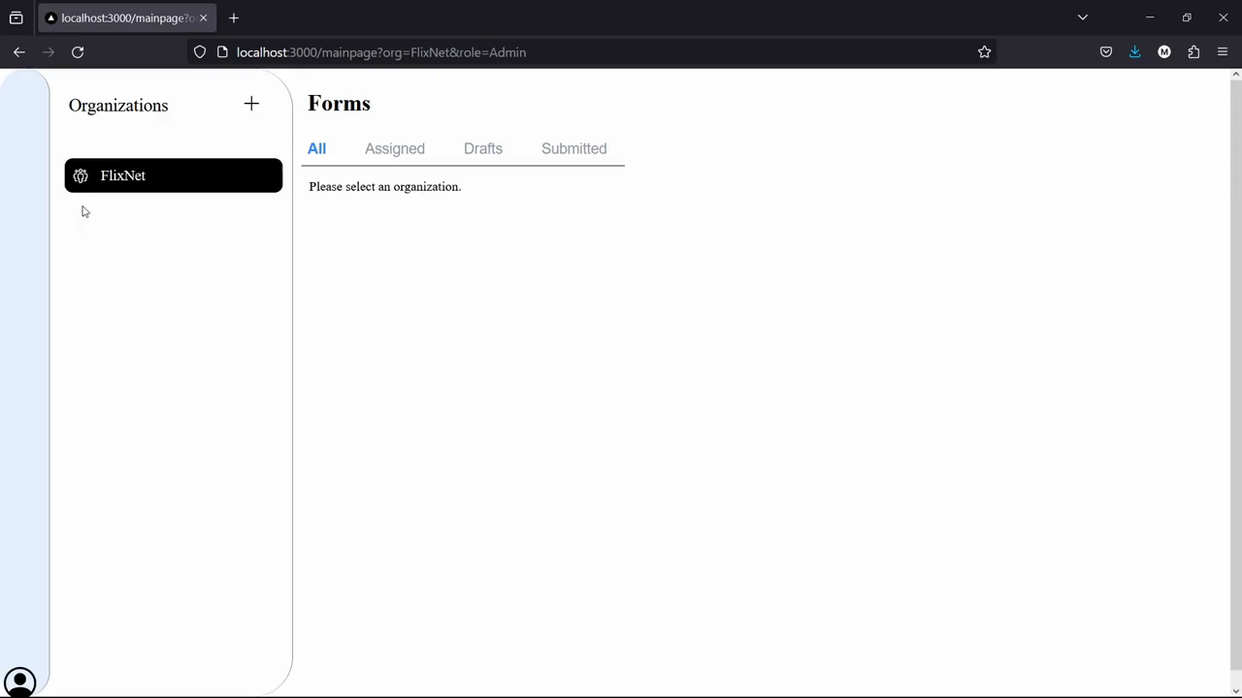

Slide 22
Questions?

